Slide 1

Sharing Powerful Stories
JPMorgan Chase
Code for Good - Houston 2017
Team 4
Batu Balimtas
Nikhil Palvai
Chris Fitzmorris
Puneeth Bikkumanla
Dana Seibert

Slide 2
Current Problems
Communication
Obsolete and slow system
Tracking volunteers
Logging hours manually, inaccurate, no shows
Event System
Planning events, organizing volunteers and materials
Awareness
Low coverage and storytelling

Slide 3
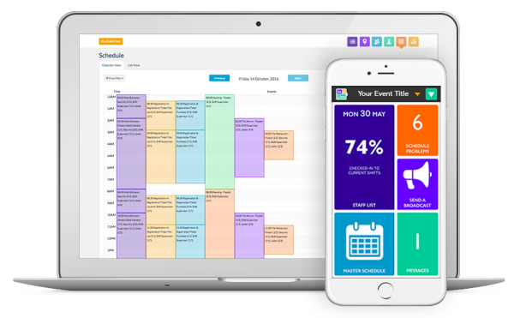
Existing Solutions
Scheduling
Communication
Event Day App
Reporting

Slide 4
Our Thoughts
01
Rework Existing Solution?
Solve Unique Problem?
02

Slide 5
Awareness
↑ 4,819 ↑
549
↓ 57% ↓
Reduction in overall
homelessness since 2011
SEARCH clients
increased
their income.
Veterans housed since 2012

Slide 6



Web Application
Stories
Platform for stories to be told
Self Service
Reduce administrative overhead
Sharing
Facebook, Twitter, Google, etc.
Impact
Recognize contributions over time and their effects

Slide 7

Demo to begin

Slide 8
Roadmap
Where to go from here
Roles for Staff
01
User Pages
02
Automated Data Entry
03
Different roles (Case Manager, Director) can have more permissions to edit or view certain events.
Self Register
04
More functionality. Allow users to customize their own pages. Feature more of their contributions.
Given this data exists in some form already, import that data and automatically arrange it to display in the timeline.
Page to allow users to register as volunteers pending approval from staff.

